Slide 1
Invoice Approval
How to View Invoices and Approve Invoices

Slide 2
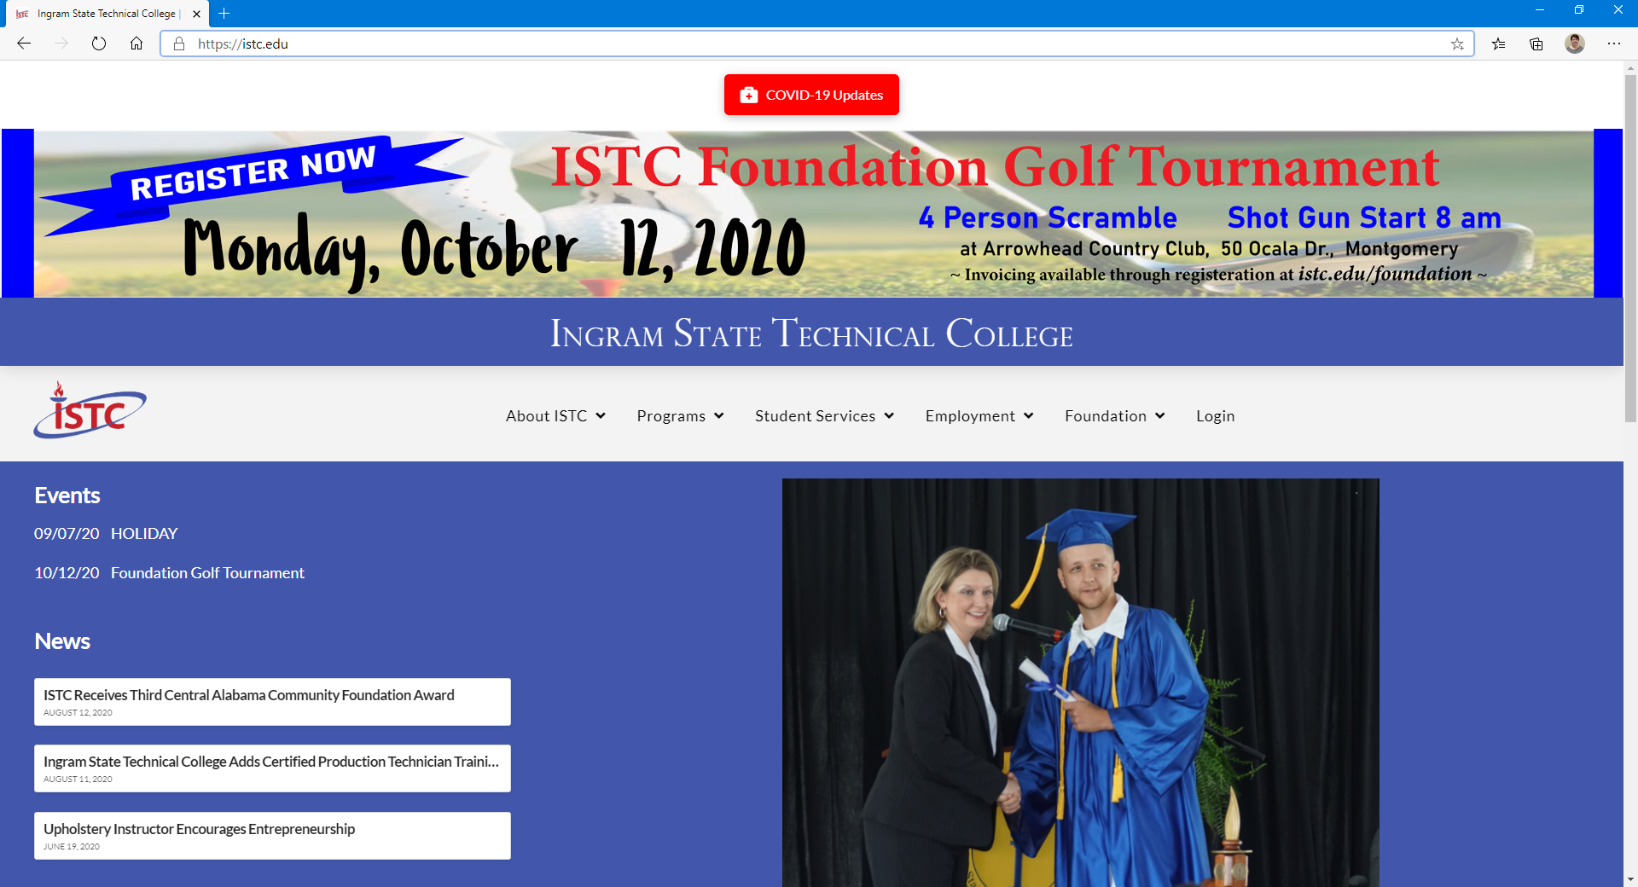
ISTC Website
Step 1
Go to https://istc.edu/
Step 2
Click Login

Slide 3
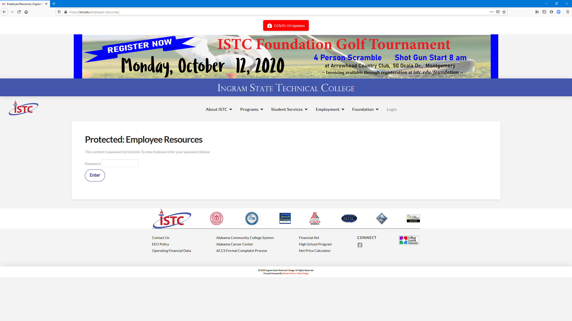
ISTC Website
Step 3
Input the password to access the Protected: Employee Resources
Step 4
Click Enter

Slide 4
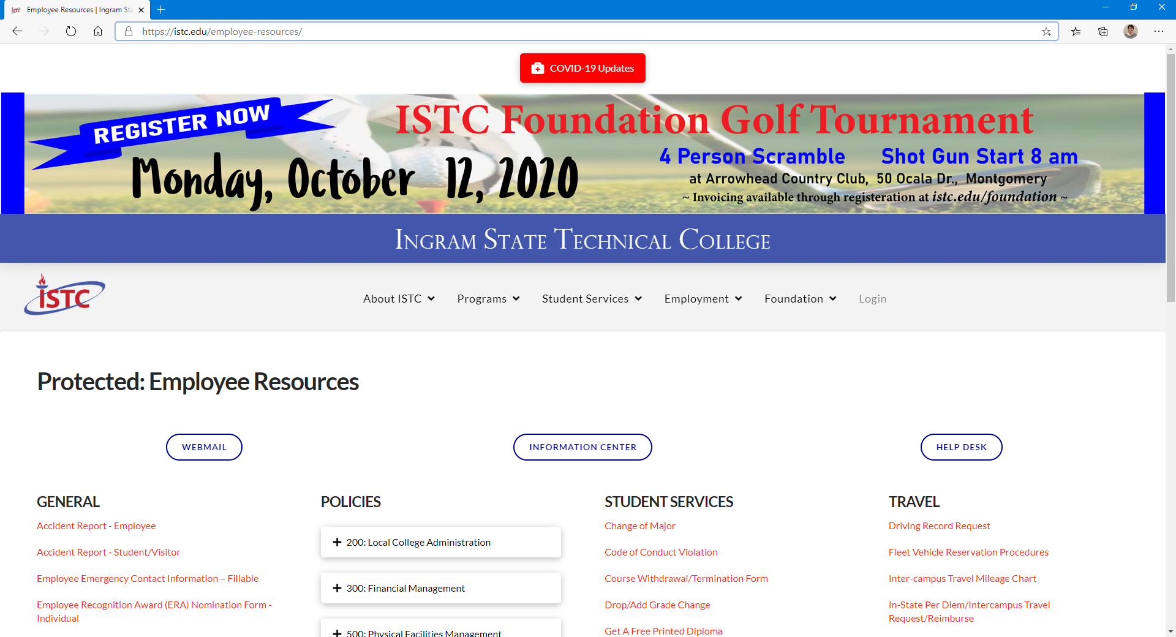
ISTC Website
Step 5
Click Information Center

Slide 5
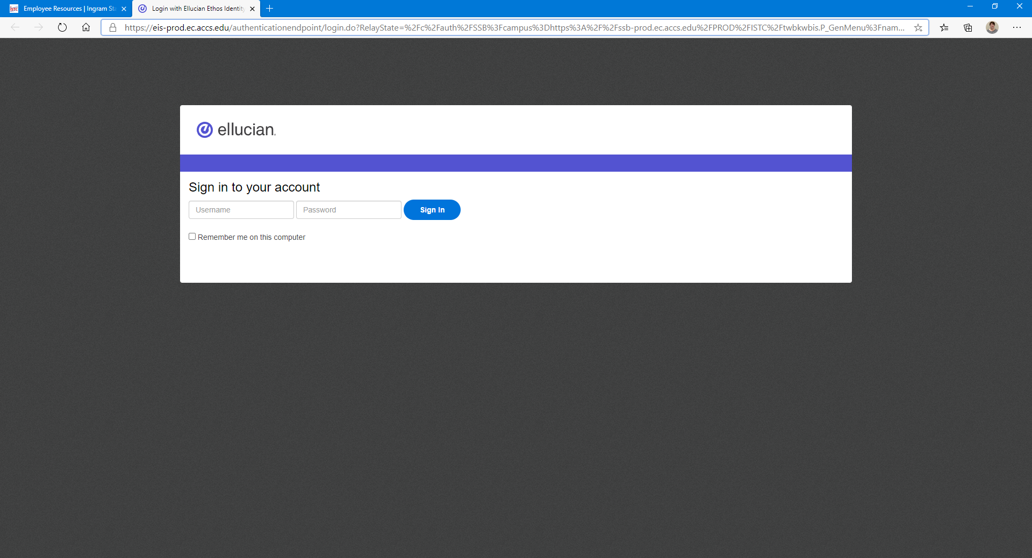
Banner Self-Service
Step 6
Username is your email address: jane.doe@istc.edu
Password is your Windows password

Slide 6
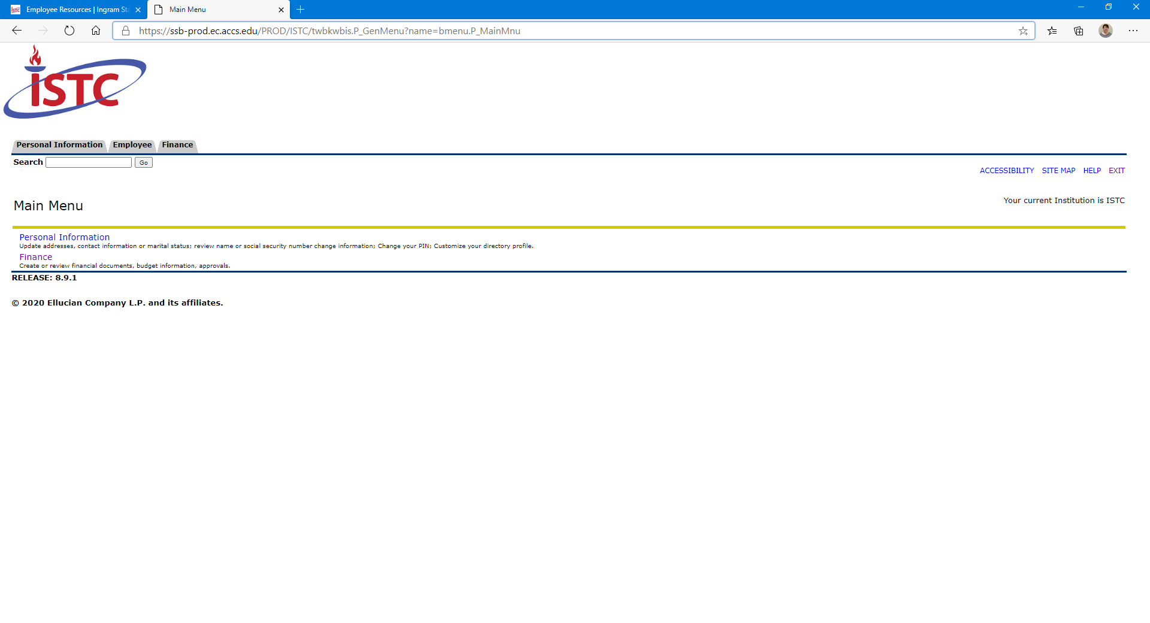
Banner Self-Service
Step 7
Click on Finance (Either place will work)

Slide 7
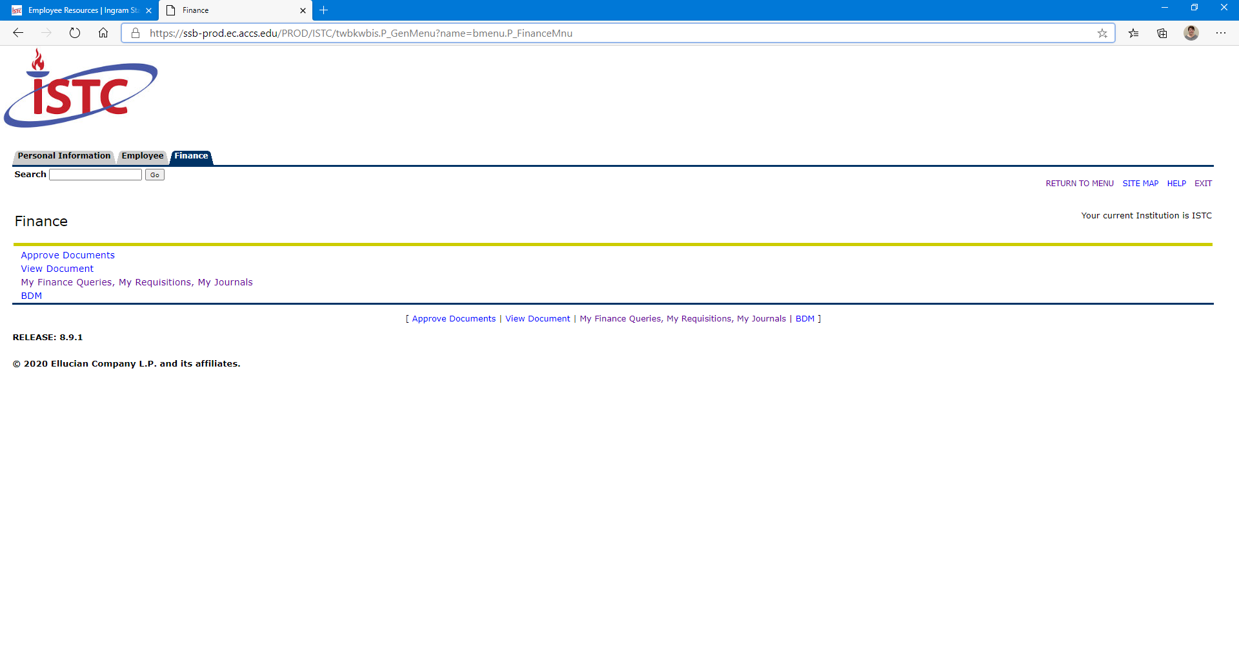
Banner Self-Service
Step 8
Right-click on My Finance Queries, My Requisitions, My Journals
Step 9
Click Open in New Tab

Slide 8
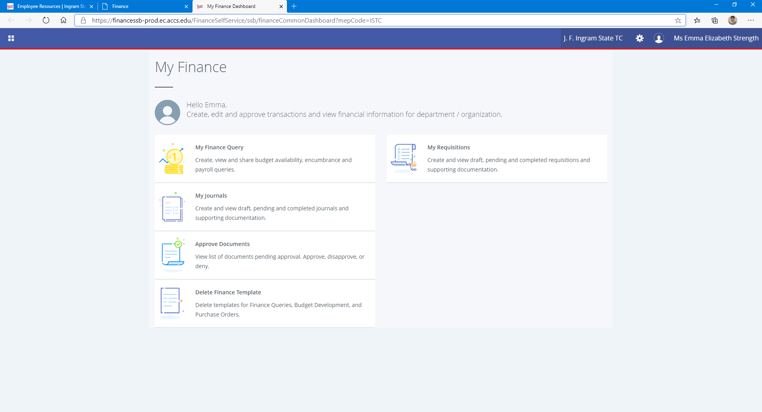
Banner Self-Service
Step 10
Click Approve Documents

Slide 9
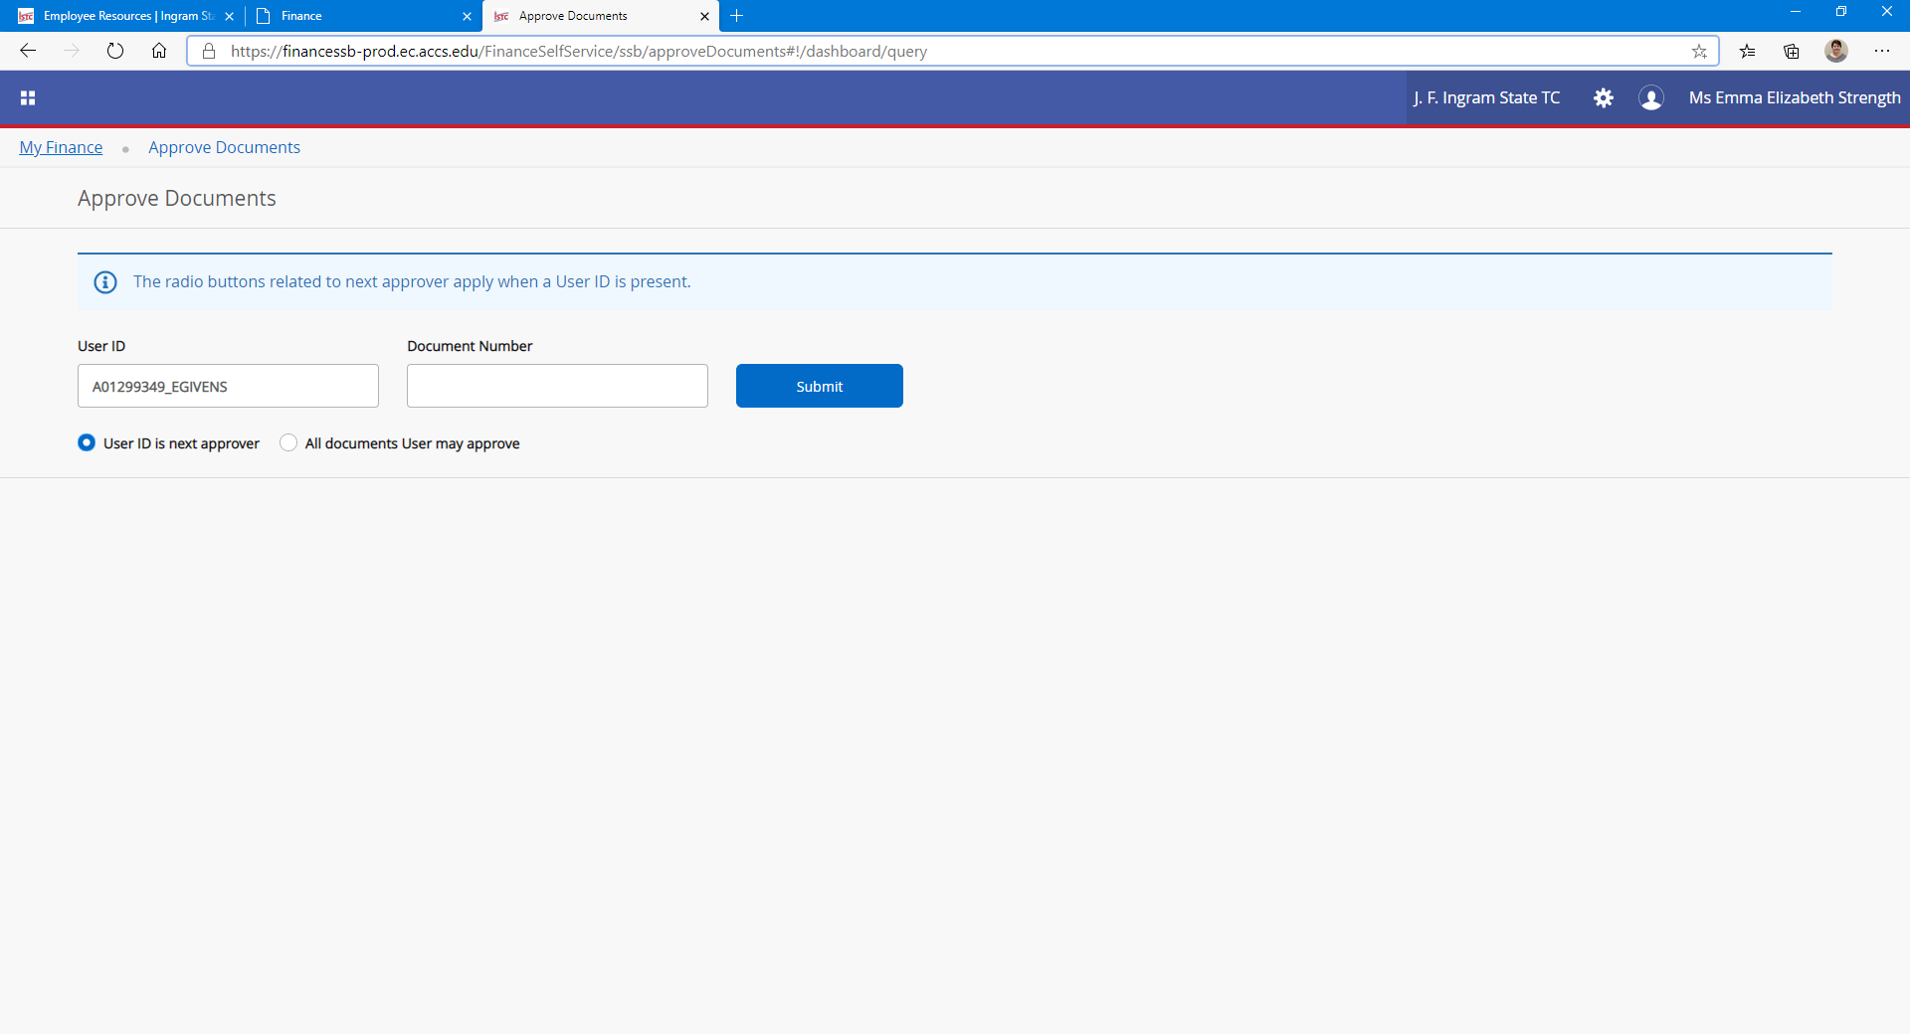
Banner Self-Service
Step 11
1) Make sure the radial button is clicked for UserID is next approver
2) Click Submit
2
1

Slide 10
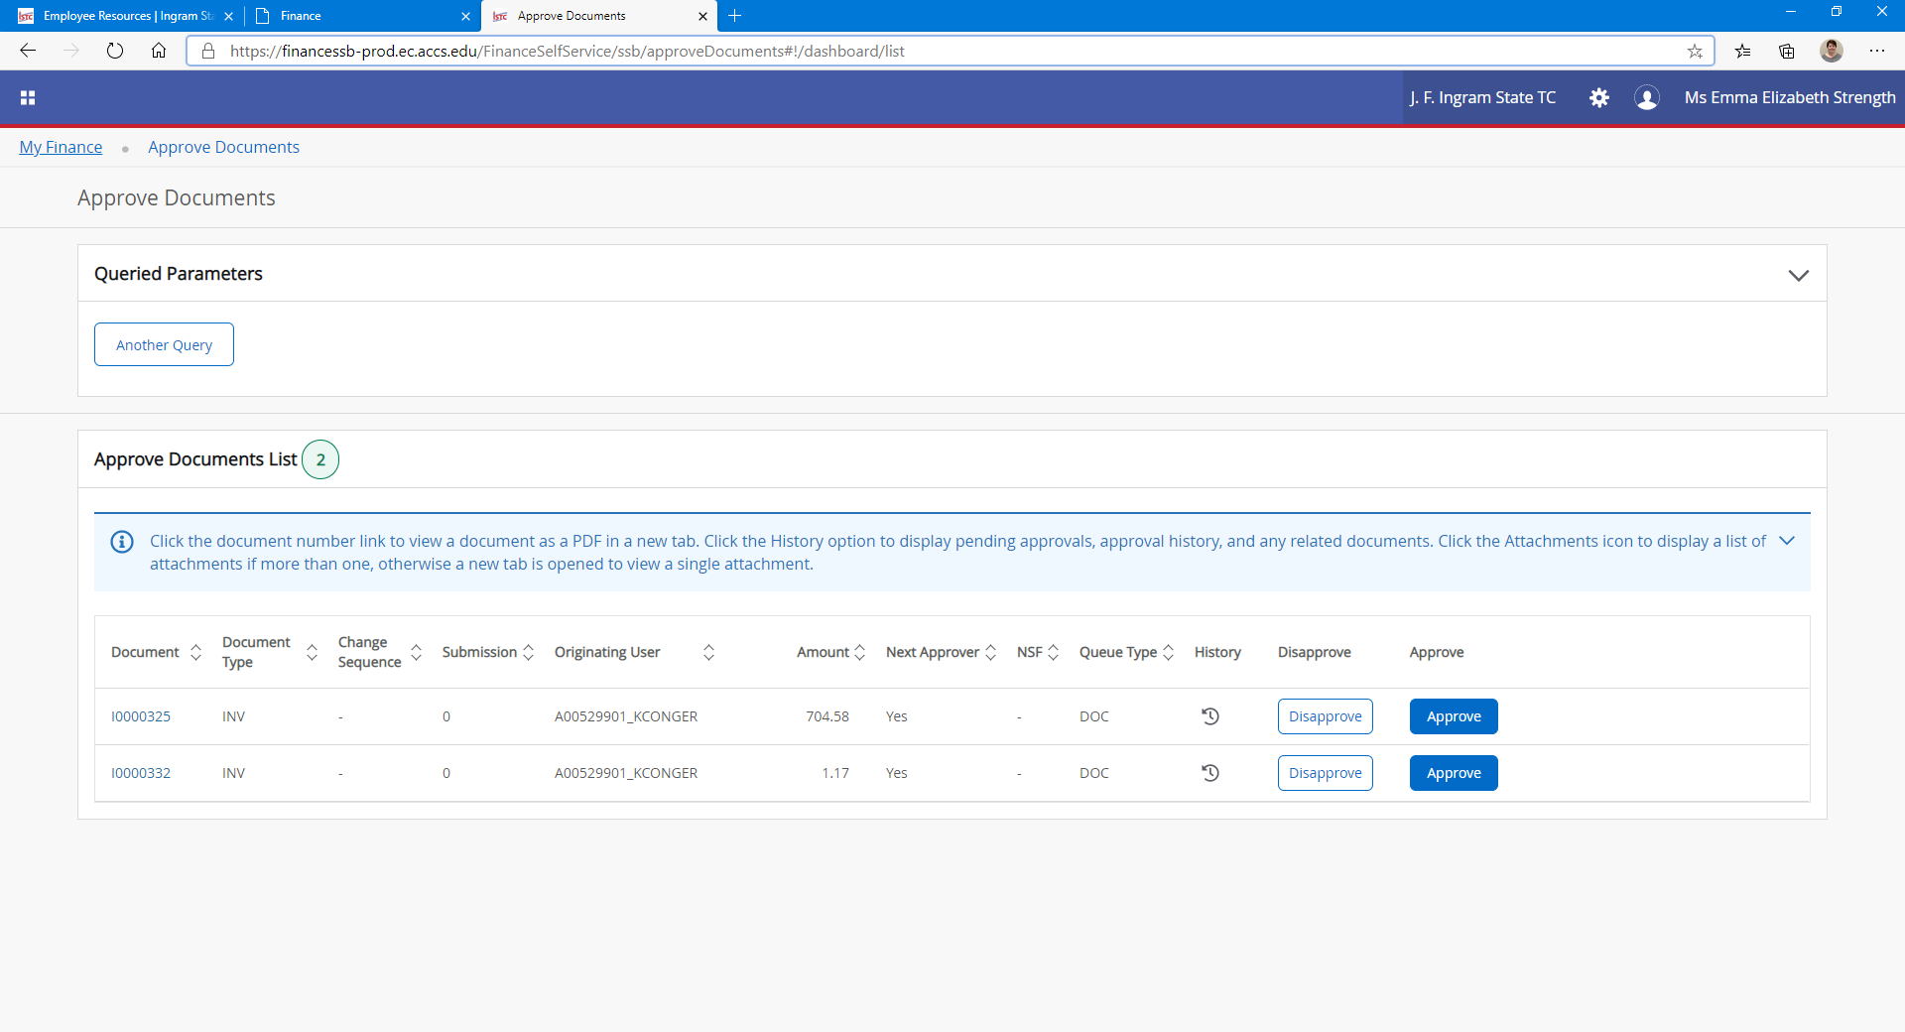
Banner Self-Service
Step 12
1) Make note of the document number
Step 13
2) Go back to the Finance tab in your browser
2
1

Slide 11
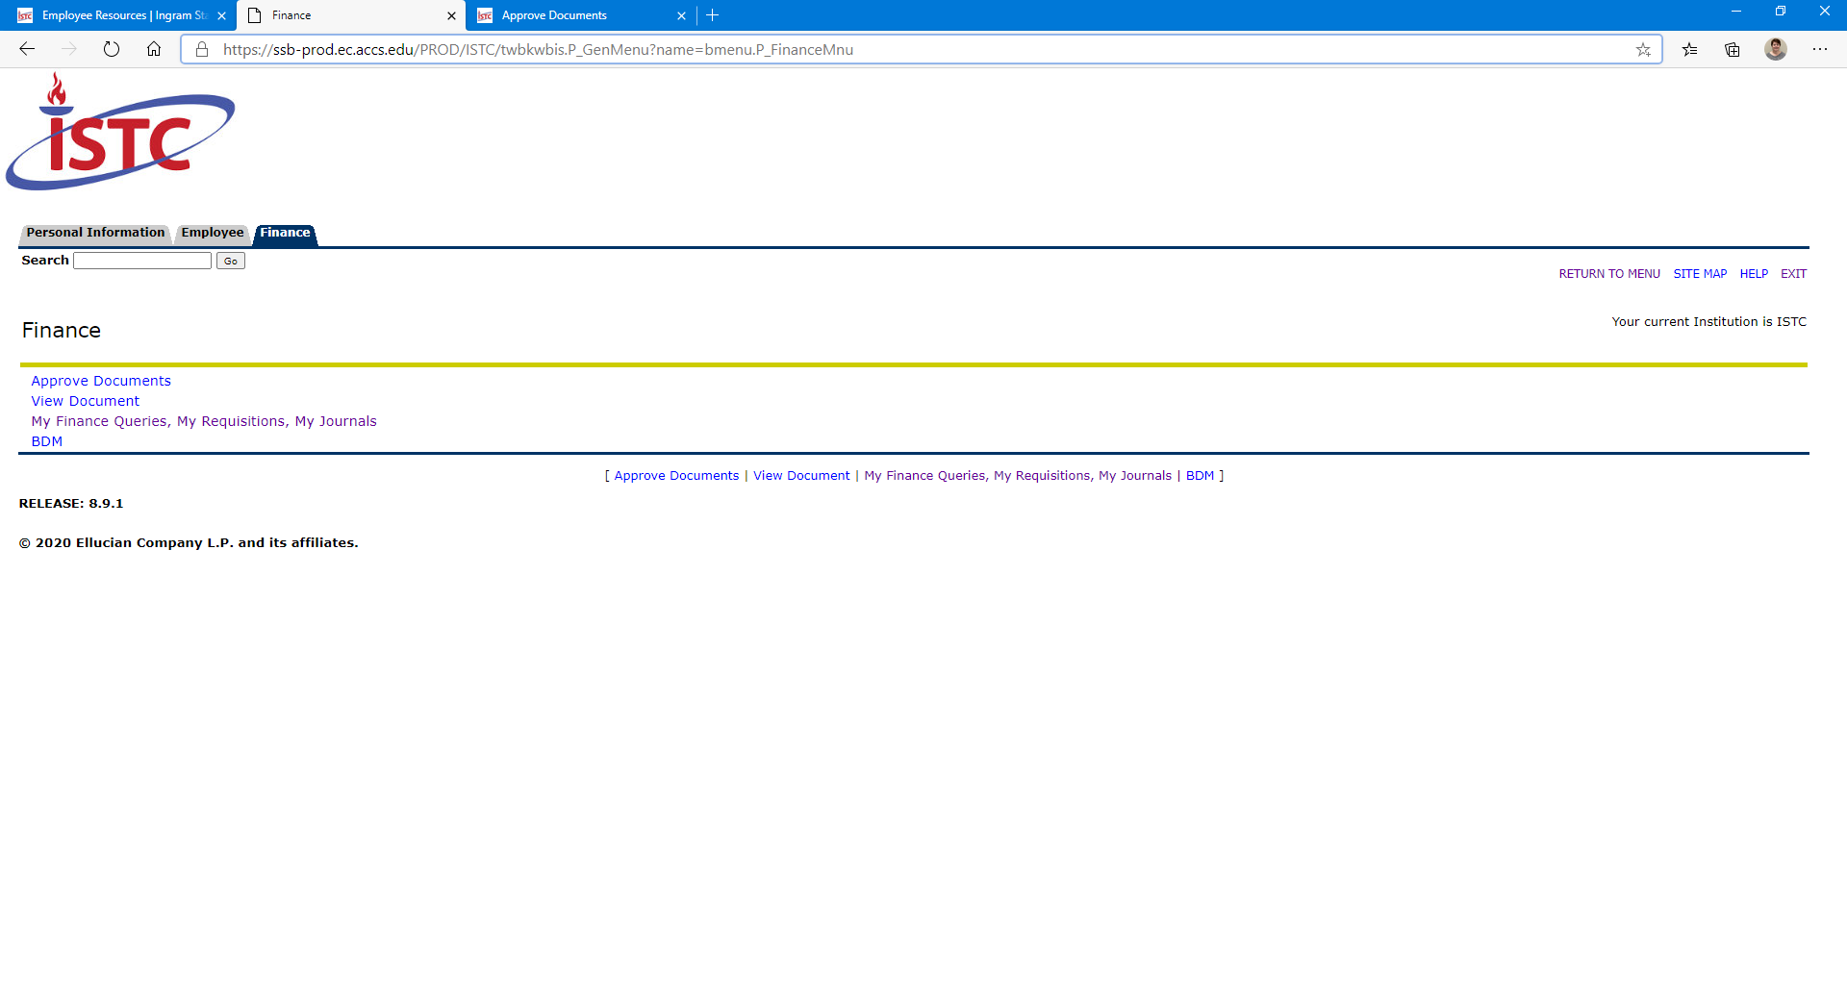
Banner Self-Service
Step 14
Click BDM

Slide 12
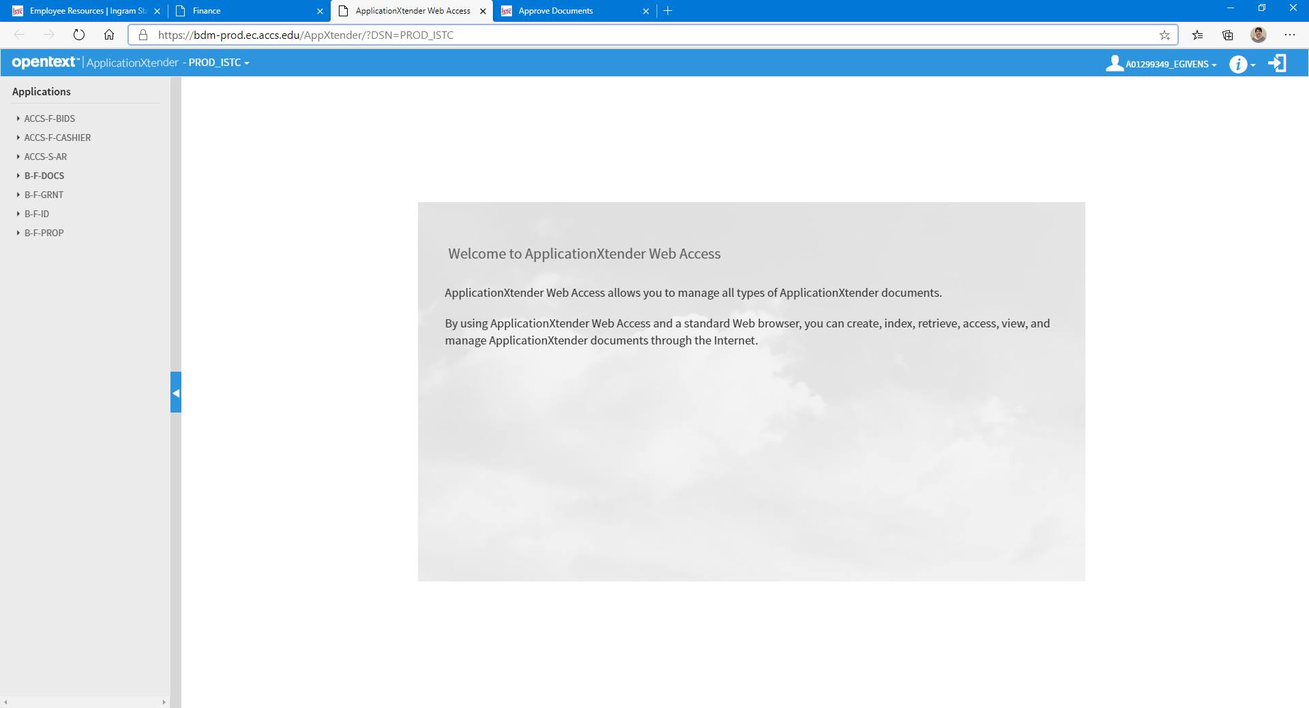
Banner Document Manager (ApplicationXtender)
Step 15
Click B-F-DOCS

Slide 13
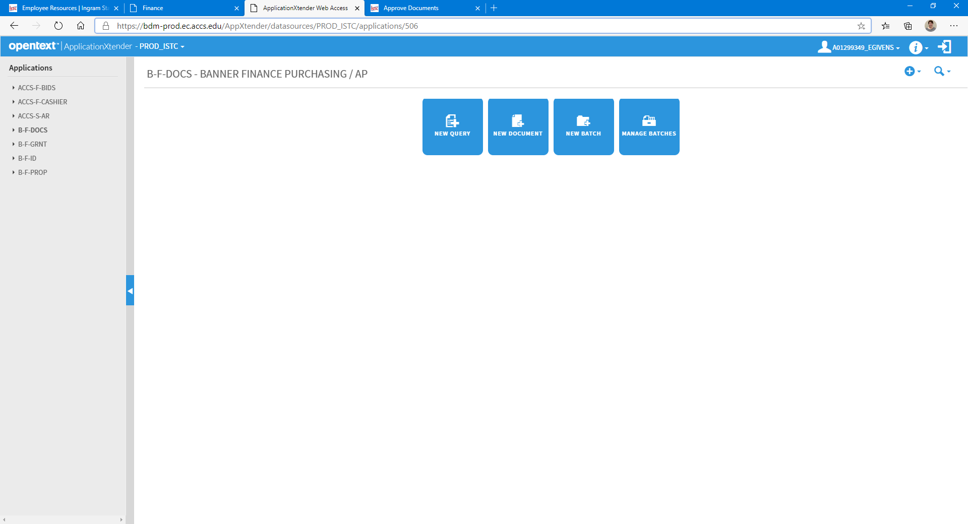
Banner Document Manager (ApplicationXtender)
Step 16
Click New Query

Slide 14
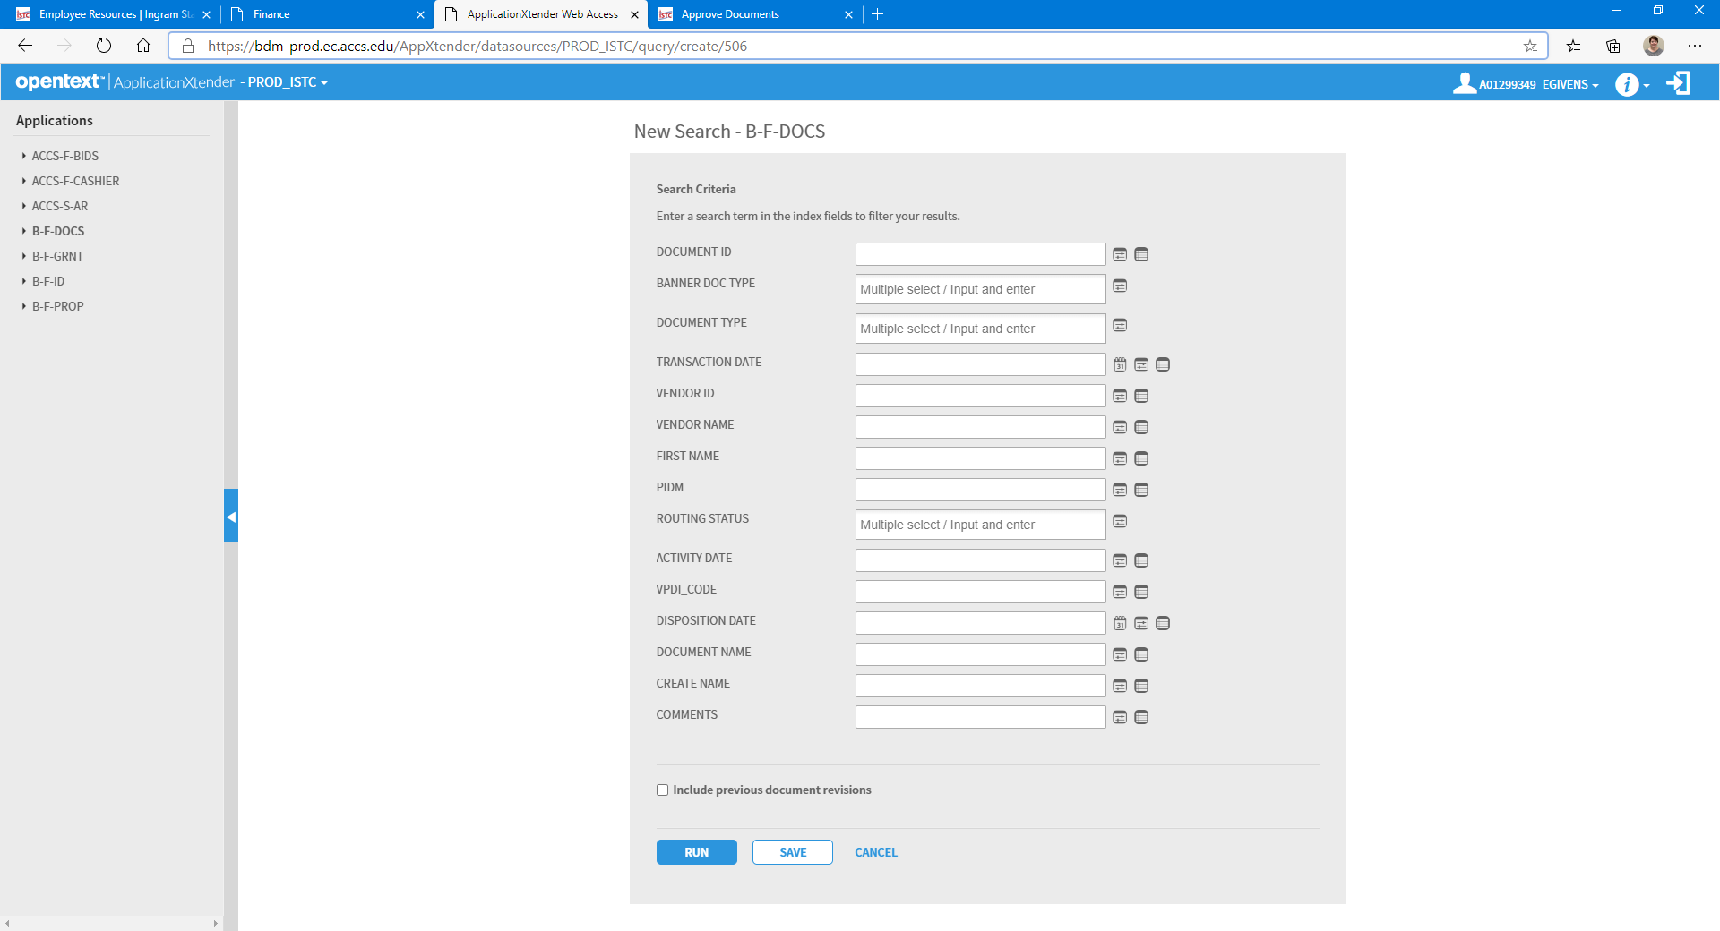
Banner Document Manager (ApplicationXtender)
Step 17
Input the notated document number in the Document ID field
Step 18
Click Run

Slide 15
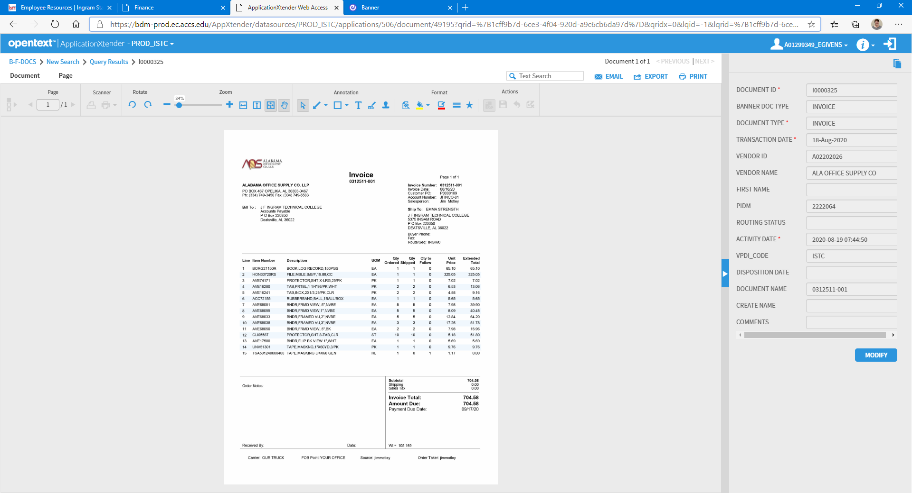
Banner Document Manager (ApplicationXtender)
You will now see the invoice associated with the notated document number
Step 19
Review the invoice

Slide 16
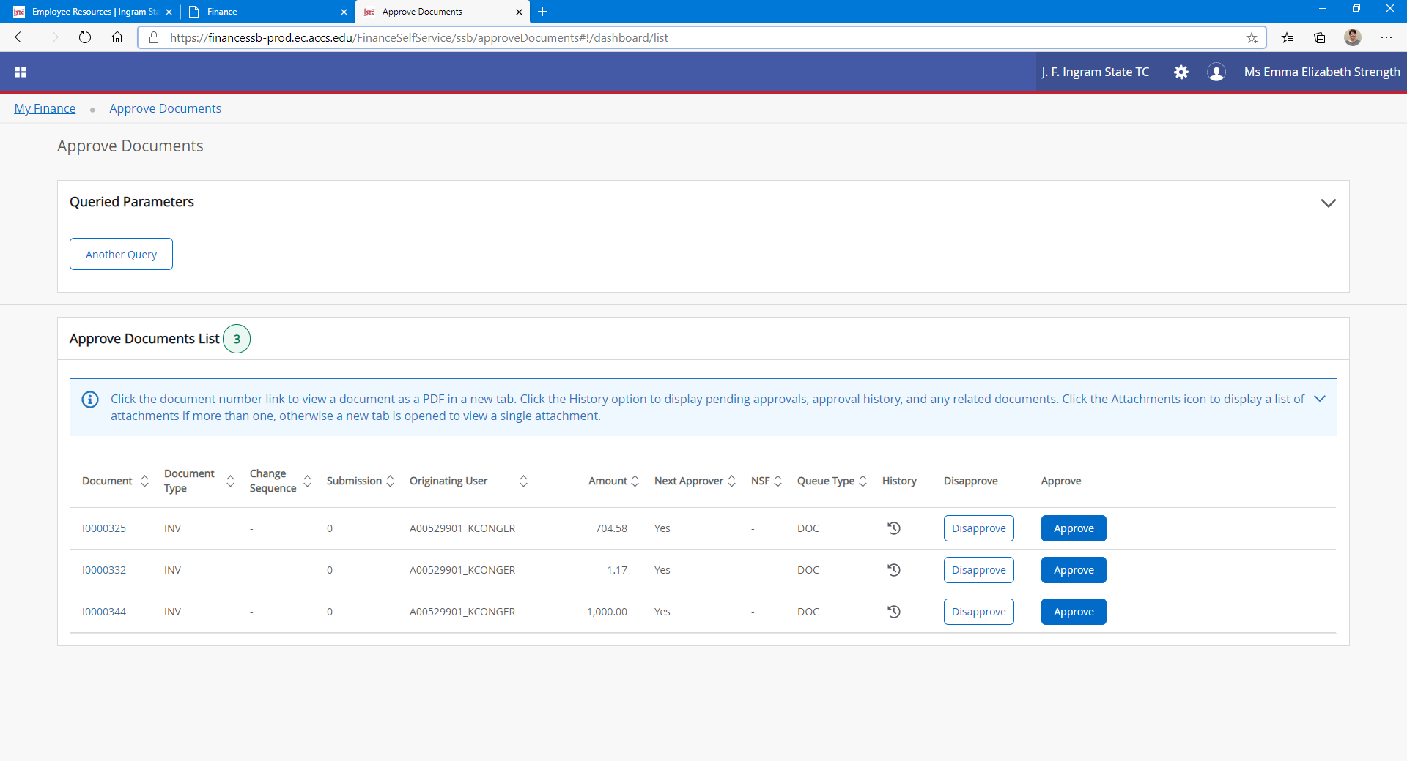
Banner Self-Service
Step 20
If you have received the items on the invoice, click Approve
If you have more invoices to approve, go back to Banner Document Manager

Slide 17
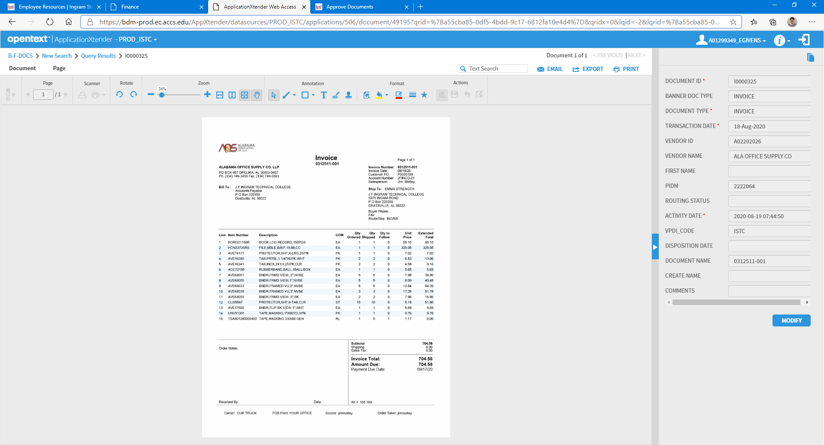
Banner Document Manager (ApplicationXtender)
Step 21
Click New Search
Step 22
Repeat Steps 17-20 for the remaining invoices

Slide 18
Notes
Only approve invoices when you have received the items

Slide 19
Questions???
Contact:
  Amelia Fox
    Ext. 4018
    amelia.fox@istc.edu
  Emma Beth Strength
    Ext. 4053
    emma.strength@istc.edu

